Slide 1


Zomato Restaurant Project
Project :- Analyse the data of Zomato
Restaurant
Submitted by
Name:- Ram kumar

Slide 2

Agenda :-
Data Description
Objective Key Metrics and Visualizations
Subjective Question for Insights
Problem Statement
Spreadsheet Project:-
Zomato Restaurants Analysis
Analyse the data of restaurant
to grow the business as per rating,
price range, cuisines,
area like city or country.

Slide 3
Problem Statement
Zomato aims to analyze restaurant data across multiple countries to understand customer preferences, restaurant performance, pricing trends, and service availability.
The objective is to identify high-potential markets, popular cuisines, and factors affecting restaurant ratings and customer engagement for future expansion strategies.
Analyze restaurant data across different countries to identify market trends, customer preferences, and business opportunities for Zomato.
Study the relationship between restaurant ratings, cuisines, pricing, votes, and online delivery services to understand customer behavior.
Use data visualization and analytics techniques to support strategic decision-making and improve overall business performance.
Evaluate the impact of table booking and online delivery services on restaurant ratings and customer satisfaction.

Slide 4
Rating v/s Avg of converted without Symbol
The analysis shows a positive relationship between
restaurant ratings and average converted
currency, indicating that higher-rated restaurants
generally have higher spending levels.
Ratings above 4.0 show a sharp increase in
average converted currency, highlighting premium
pricing for highly rated restaurants.
The highest average spending is observed around
ratings 4.7–4.9, suggesting strong customer
willingness to pay for better dining experiences.

Slide 5
Count of Restaurant as per Country
Canada has the highest number of restaurants
compared to other countries, showing it as the
dominant market in the dataset.
Restaurant counts across years remained
mostly stable, with slight declines during
2012–2016 and growth again in 2017–2018.
The upward trend in recent years indicates
increasing restaurant expansion opportunities
in selected regions.

Slide 6
Average rating of Is delivering now
Table Booking Impact:
Restaurants without table booking: Avg rating ≈ 2.81
Restaurants with table booking: Avg rating ≈ 3.48.
Insight: Table booking has an even stronger
positive impact on ratings.
Online Delivery Impact: Restaurants without online delivery: Avg rating ≈ 2.89 Restaurants with online delivery: Avg rating ≈ 3.18.
Insight: Online delivery improves customer
satisfaction and ratings.

Slide 7
TOP 10 CUISINES
North Indian cuisine dominates the chart with
the highest popularity score of 2009.3, making
it the most preferred cuisine among customers.
North Indian–Chinese and North Indian–Mughlai combinations are also highly popular, showing
strong customer interest in fusion cuisines.
Street Food and Bakery-related cuisines have comparatively lower scores, indicating niche but steady customer demand.

Slide 8
Average Price Range Analysis (Country-wise)
Highest price ranges observed in:
Qatar & Singapore (~3.65), South Africa
(~3.58), Philippines (~3.36)
Moderate price range countries:
Brazil (~3.4), New Zealand (~3.15), UAE
(~3.21).
Lower price range countries:
India (~1.72), USA (~2.04), Australia (~2.12).
India has the lowest average price range →
Strong budget-friendly market.

Slide 9
Customer Engagement Analysis (Average Votes by Country)
Highest engagement (votes): Indonesia
(~772), UAE (~493), Turkey (~431), USA
(~428), Philippines (~407), Strong customer
interaction & popularity.
Lower engagement markets:
Brazil (~19), Singapore (~31), Canada
(~103) Lower visibility or fewer active users.
Large variation across countries (~20 to 770) Engagement does not always correlate with price.

Slide 10
Country wise Average Rating
The average restaurant ratings are fairly
balanced across most countries, with
ratings generally ranging between 5%
and 8%.
The Philippines has the highest average
rating share at 8%, while India shows the
lowest contribution at 5%.
Countries like Turkey, Sri Lanka, South Africa, Qatar, UAE, UK, and USA maintain similar
average ratings, indicating consistent customer
satisfaction globally.

Slide 11
Year wise Count
The number of restaurants remained relatively
stable from 2010 to 2018, with yearly counts
ranging between 1,024 and 1,102.
2018 recorded the highest number of
restaurants (1,102), showing a gradual
growth trend in recent years.
A total of 9,551 restaurants were analyzed
across the nine-year period, providing a
strong dataset for market analysis.

Slide 12
Has Table Booking v/s Average of Rating
Restaurants offering table booking have a higher
average rating contribution (55%) compared to
restaurants without table booking (45%).
The data suggests that table booking services
positively influence customer satisfaction and
dining experience.
Providing reservation facilities can help restaurants
Improve ratings and attract more customers.

Slide 13
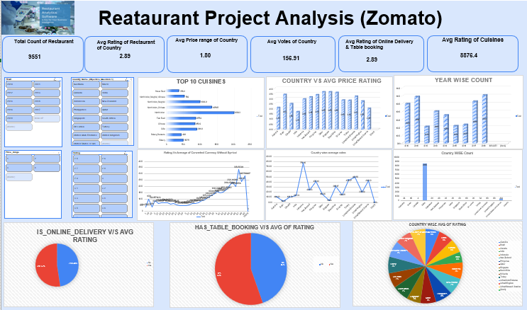

Slide 14

Dashboard Analysis
The dashboard analysis of 9,551 restaurants highlights an average restaurant rating of 2.89 and an average customer voting count of 156.91 across different countries.
North Indian cuisine emerged as the most
popular cuisine category, while combinations
like North Indian–Chinese and Mughlai
also showed strong customer preference.
Country-wise and year-wise analysis shows
stable restaurant growth trends, with similar
average ratings across most countries, reflecting
consistent global dining experiences.
Restaurants providing online delivery and table booking services received comparatively higher average ratings, indicating better customer satisfaction and convenience.

Slide 15
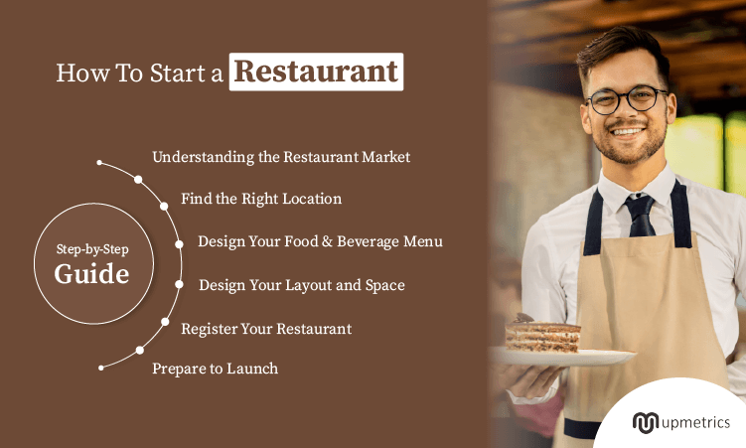
Key Points to Open a New Restaurant
The restaurant should have a clear concept
and not try to serve too many cuisines.
Location should be selected based on the
target customer group, such as students,
families, or working professionals.
Pricing should be competitive and aligned
with customer expectations in that area.
The menu should be limited, focused, and
easy to execute efficiently.
Popular and high-demand cuisines should be
prioritized to attract more customers.

Slide 16

Recommendations:-
<Actionable recommendations based on the insights>
Focus expansion on high-demand cities with manageable competition levels.
Target locations with strong customer ratings and active restaurant markets.
Introduce restaurants in cities with growing populations and purchasing power.

Slide 17

🧠 Conclusion Restaurant
Success depends on a combination of factors rather than a single element.
Ratings improve when there is a balance between location, pricing, menu design, cuisine selection, and service quality.
A well-planned, customer-focused, and data-driven approach increases the chances of long-term success

Slide 18


